Slide 1

Python exception error

Slide 2
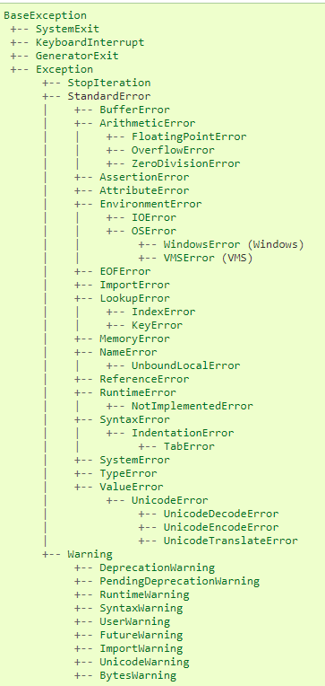
Python exception Hierarchy

Slide 3
Recap
try: It will run the code block in which you expect an error to occur.
except: Here, you will define the type of exception you expect in the try block (built-in or custom).
else: If there isn't any exception, then this block of code will be executed (consider this as a remedy or a fallback option if you expect a part of your script to produce an exception).
finally: Irrespective of whether there is an exception or not, this block of code will always be executed.

Slide 4

Keyboard Interrupt Error
try:
inp = input()
print ('Press Ctrl+C or Interrupt the Kernel:')
except KeyboardInterrupt:
print ('Caught KeyboardInterrupt')
else:
print ('No exception occurred')

Slide 5

Standard Error
Arithmetic Error
Zero Division Error
OverFlow Error
Floating Point Error

Slide 6
Zero Division
try:
a = 100 / 0
print (a)
except ZeroDivisionError:
print ("Zero Division Exception Raised." )
else:
print ("Success, no error!")
When the divisor (second argument of the division) or the denominator is zero, then the resultant raises a zero division error.

Slide 7

OverFlow Error
try: import math print(math.exp(1000)) except OverflowError: print ("OverFlow Exception Raised.") else: print ("Success, no error!")
The Overflow Error is raised when the result of an arithmetic operation is out of range. OverflowError is raised for integers that are outside a required range.

Slide 8
Assertion Error
try:
a = 100
b = "DataCamp"
assert a == b
except AssertionError:
print ("Assertion Exception Raised.")
else:
print ("Success, no error!")
When an assert statement is failed, an Assertion Error is raised.

Slide 9
Value Error
Value error is raised when the built-in operation or a function receives an argument that has a correct type but invalid value.
try: print (float('DataCamp')) except ValueError: print ('ValueError: could not convert string to float: \'DataCamp\'') else: print ('Success, no error!')

